Slide 1
Introduction to
JAVA

Slide 2

What is Java?
An island
Largest island of the equatorial achipelago of Indonesia
Famous for beaches and coffee
A language
Developed by Sun
Open specification

Slide 3
The History of Java Technology
Java - The new programming language developed by Sun Microsystems in 1991.
Originally called Oak by James Gosling, one of the inventors of the Java Language.
Java Authors: James Gosling, Arthur Van , and others
Originally created for consumer electronics (TV, VCR, Freeze, Washing Machine, Mobile Phone).
Java - CPU Independent language
Internet and Web was just emerging, so Sun turned it into a language of Internet Programming.

Slide 4
Java Milestones - 1
Year | Development
1990 | Sun decided to developed special software that could be used for electronic devices. A project called Green Project created and head by James Gosling.
1991 | Explored possibility of using C++, with some updates announced a new language named “Oak”
1992 | The team demonstrated the application of their new language to control a list of home appliances using a hand held device.
1993 | The World Wide Web appeared on the Internet and transformed the text-based interface to a graphical rich environment. The team developed Web applets (time programs) that could run on all types of computers connected to the Internet.

Slide 5
Java Milestones - 2
Year | Development
1994 | The team developed a new Web browsed called “Hot Java” to locate and run Applets. HotJava gained instance success.
1995 | Oak was renamed to Java, as it did not survive “legal” registration. Many companies such as Netscape and Microsoft announced their support for Java
1996 | Java established itself it self as both 1. “the language for Internet programming” 2. a general purpose OO language.
1997- | A class libraries, Community effort and standardization, Enterprise Java, Clustering, etc..

Slide 6
Java is Compiled and Interpreted
Programmer
Hardware and
Operating System
Source Code
Byte Code
Text Editor
Compiler
Interpreter
.java file
.class file
Notepad, emacs,vi
javac
java
appletviewer
netscape

Slide 7
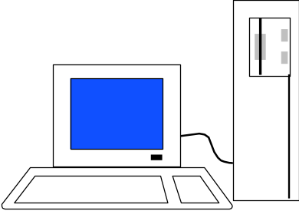
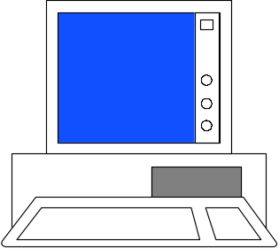
Total Platform Independence
JAVA COMPILER
(translator)
JAVA BYTE CODE
(same for all platforms)
JAVA INTERPRETER
(one for each different system)
Windows 95
Macintosh
Solaris
Windows NT

Slide 8

Rich Class Environment
Core Classes
  language
  Utilities
  Input/Output
  Low-Level Networking
  Abstract Graphical User Interface
Internet Classes
  TCP/IP Networking
  WWW and HTML
  Distributed Programs

Slide 9
Java Applications
We can develop two types of Java programs:
  Stand-alone applications
  Application- A stand-alone program that can be invoked from command line . A program that has a “main” method
  Web applications (applets)
  Applet- A program embedded in a web page , to be run when the page is browsed . A program that contains no “main” method
Application –Executed by the Java interpreter.
Applet- Java enabled web browser.

Slide 10
Java Class Lifecycle
Source File
(.java)
Java Virtual Machine (JVM)
ClassLoader
Compiler
(javac)
Bytecode Verifier
Interpreter
Just-in-time compiler
Class File
(.class)
Network
or
File System
Security Manager
= security gateway
Operating System

Slide 11
Let us Try Out
Building your first Java Program

Slide 12
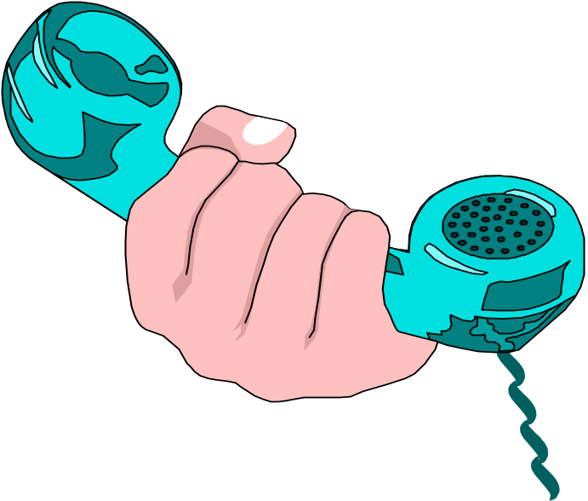
Hello World
// HelloWorld.java: Hello World program
public class HelloWorld
{
public static void main(String args[])
{
System.out.println(“Hello World”);
}
}

Slide 13
Program Processing
Compilation
  # javac HelloWorld.java
  results in HelloWorld.class
Execution
  # java HelloWorld
  Hello World
  #

Slide 14
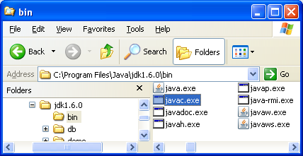
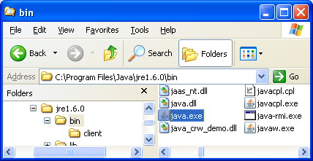
How can Java support platform-independence?
file.java (plain text)
Java Compiler
Javac.exe
Platform-Independent
Java byte-code: file.class
Java Runtime Interpreter / Java Virtual Machine (java.exe)
IBM
Macintosh
Sparc
Session 01 - Getting started

Slide 15
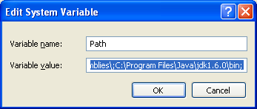
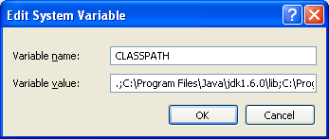
Set up Environment Variables
After installing JavaSE (Java Development Kit Standard Edition), environment variables should be setup to point to the folder in which JavaSE is installed.
Steps: My Computer/ Properties/ Advanced/Environment Variables/System Variables/ Path/ Edit
Why?
The point at the beginning of the CLASSPATH means that classes will be searched first in the current working folder.
Session 01 - Getting started
Notes:
Path is an environment variable that specifies the location of executable files. Path specifies locations where Windows searches an application
Classpath is an environment variable that specifies the location of the class files and libraries needed for the Java compiler (javac) to compile applications

Slide 16
The first Java program in the NetBeans
This program will show the string “Hello World” to the screen.
Steps
  1- Create a new Java NetBeans project
  2- Add a Java class
  3- Write code
  4- Compile/Run the program
Session 01 - Getting started

Slide 17
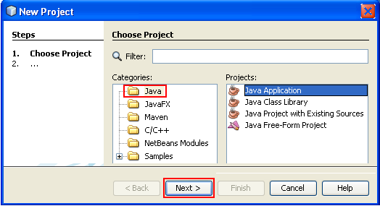

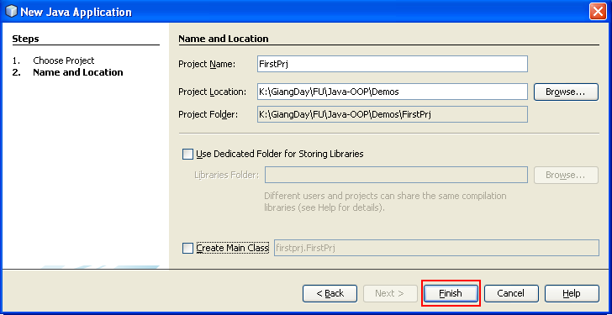
Step 1- New Project
If this option is checked, NetBeans will automatically generate a class, named Main, for the project.
If this option is not checked, we can create some programs in one project.
Session 01 - Getting started

Slide 18
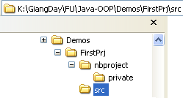
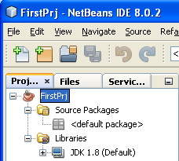
New Project…: Initial Project Structure
In Windows Explorer
In NetBeans
Session 01 - Getting started

Slide 19
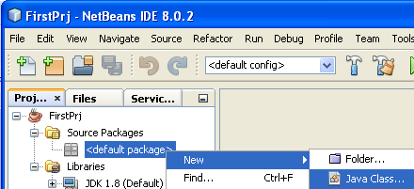
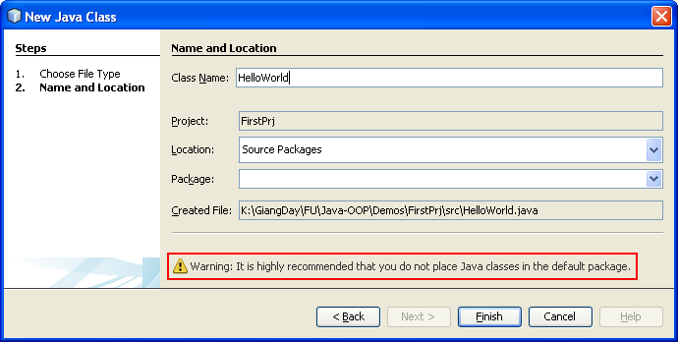
Step 2: Add a Java Class
Package: Subdirectory of the folder Project/SRC
Read
recommendation
In this demo, we do not specify package intentionally
Session 01 - Getting started

Slide 20
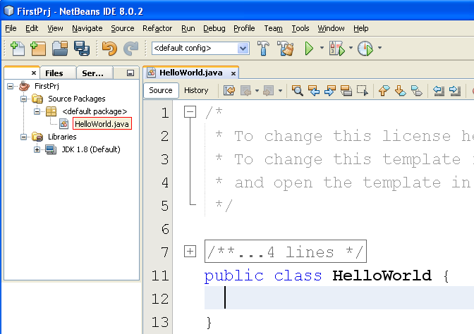
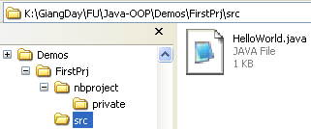
Add a Java Class…
In Windows Explorer
In NetBeans
Session 01 - Getting started

Slide 21
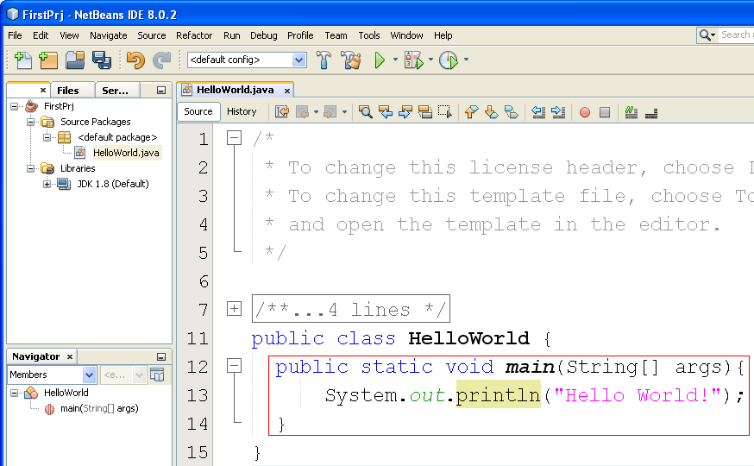
Step 3: Write code
Session 01 - Getting started

Slide 22


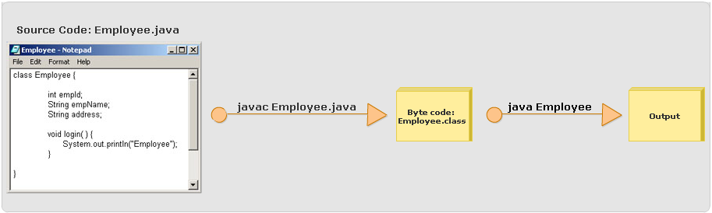
Explain JDK and its tools
javac (Java compiler)
java (Java interpreter)
Session 01 - Getting started

Slide 23
Summary
An overview of Java technology as a whole.
What to download, what to install, and what to type, for creating a simple "Hello World!" application.
Discusses the "Hello World!" application.
Session 01 - Getting started

